Slide 1
Incentivising Biodiversity Data Publishing: GBIF-Pensoft Partnership Vishwas Chavan¹, Lyubomir Penev^{2,3}, Teodor Georgiev³ 1 Global Biodiversity Information Facility, Copenhagen, Denmark (vchavan@gbif.org) 2 Institute for Biodiversity and Ecosystem Research, Bulgarian Academy of Sciences, 2 Gagarin Str., 1113 Sofia, Bulgaria 3 Pensoft Publishers, 13a Geo Milev Str., Sofia, Bulgaria
TDWG Florence, 27 Oct - 1 Nov 2013
ViBRANT

Slide 2
Multiple Data Publishing Model
Supplementary data files published along with an article
Data deposited at specialized data repositories (Dryad, Pangaea) and linked to the article
Data published through data repositories according to a standard but indexed and collated with other data (GenBank, GBIF IPT)
Integrated narrative (text) and data publishing

Slide 3
The problem ?

Slide 4
Low uptake of open data publishing/sharing

Slide 5
As a result, data often get lost!
Primary data

Slide 6
A solution?

Slide 7
Data Paper is a scholarly journal publication whose primary purpose is to describe a dataset or a group of datasets, rather than to report a research investigation.

Slide 8
Data papers
Provide a citable journal publication that brings scholarly credit to data publishers
Describe the data in a structured human-readable form
Bring the existence of the data to the attention of the scholarly community

Slide 9
How it started

Slide 10
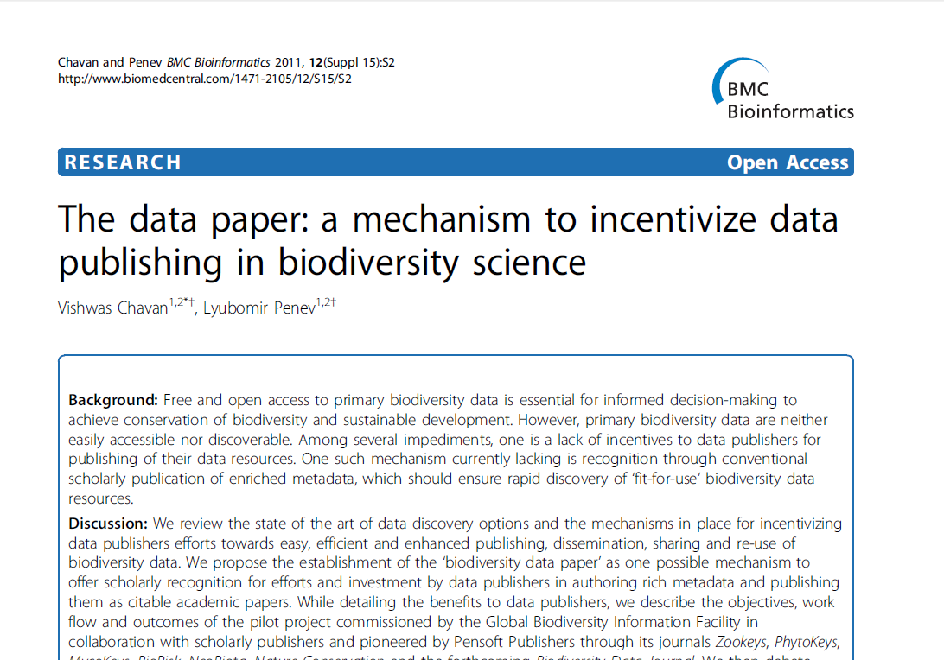
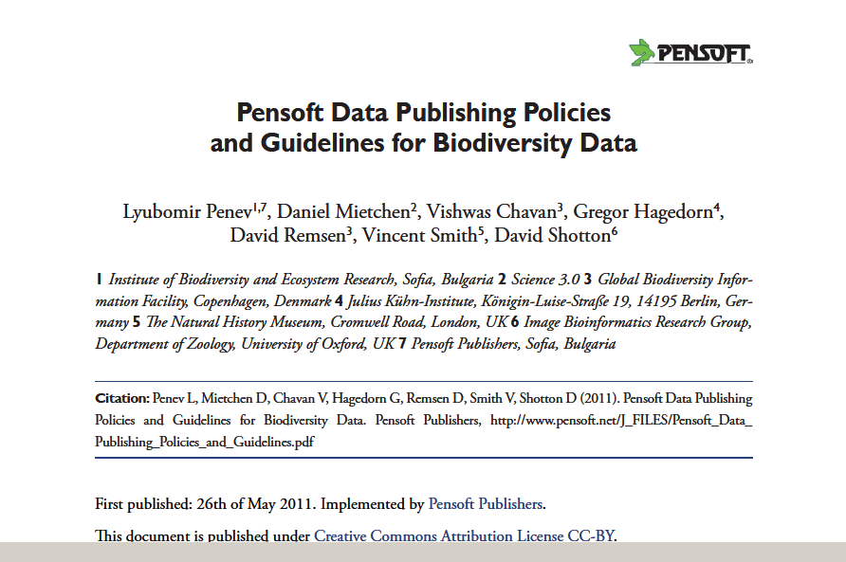
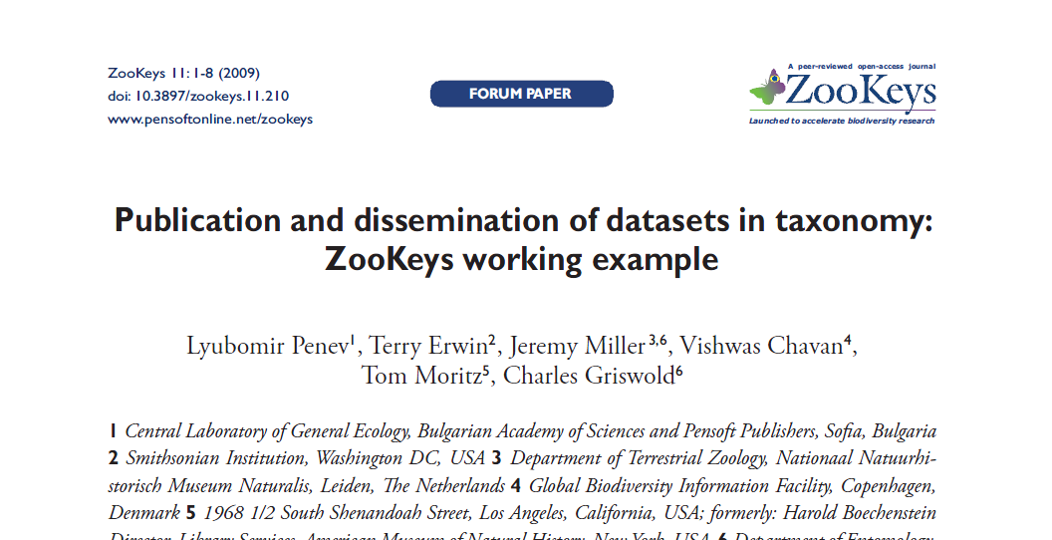

Slide 11
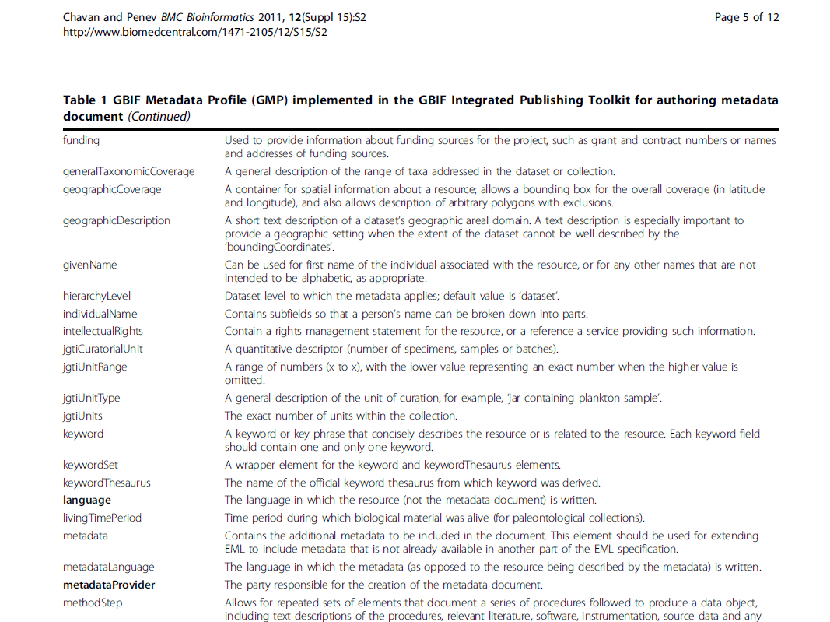
Metadata based on the Ecological Metadata Language (EML)

Slide 12
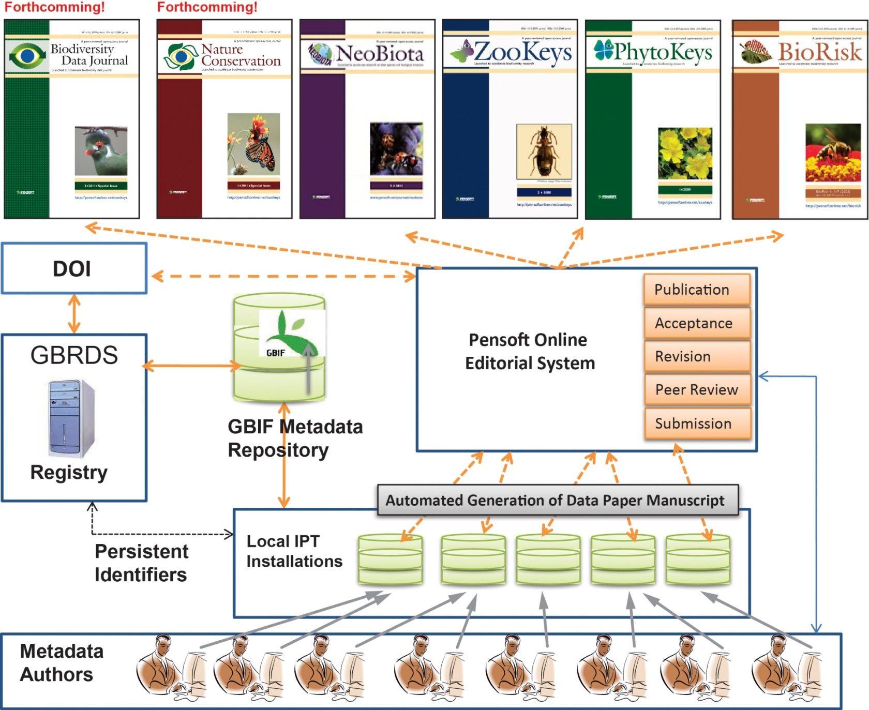
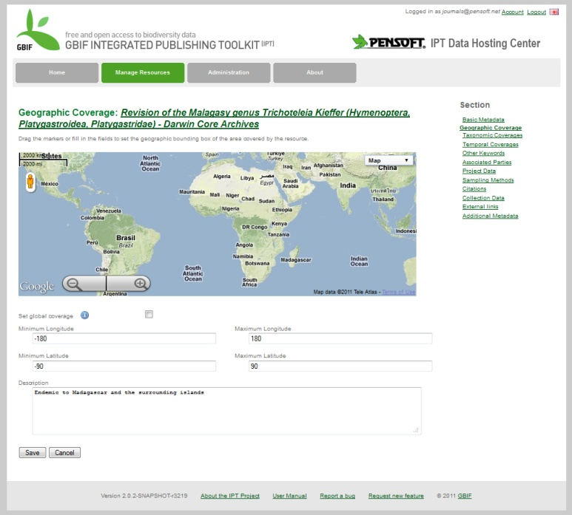
Data papers from GBIF IPT
IPT

Slide 13
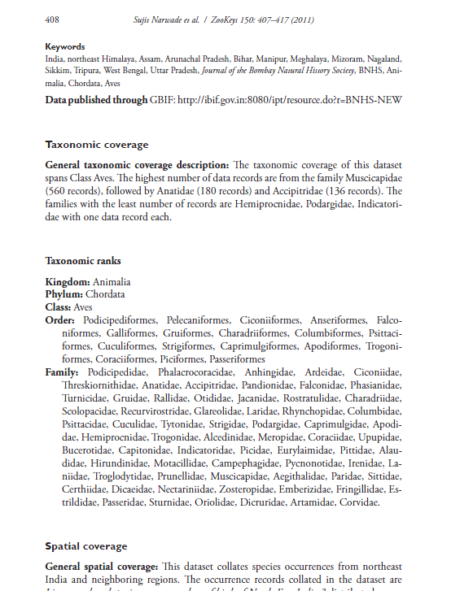
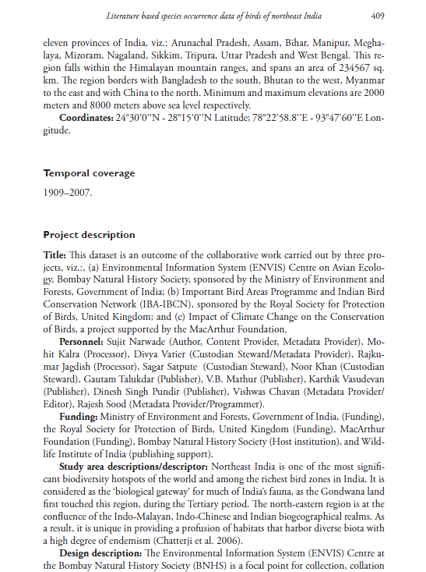
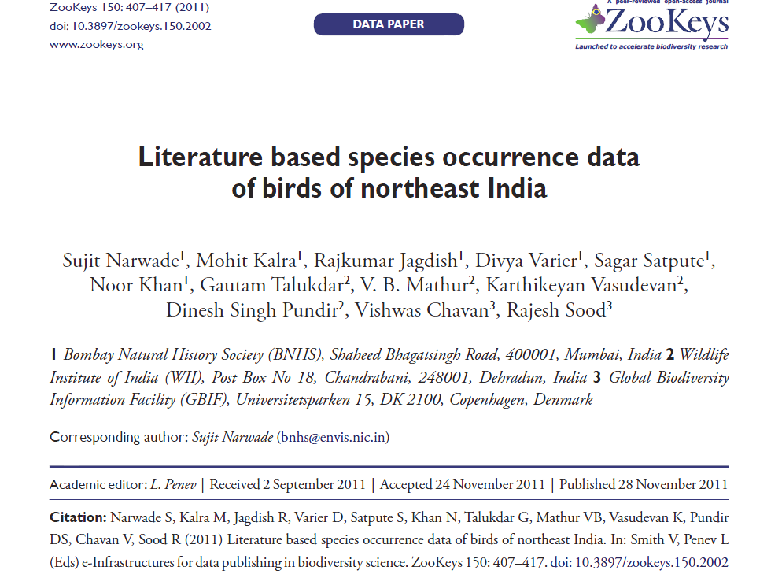
Data publised through Data Papers

Slide 15
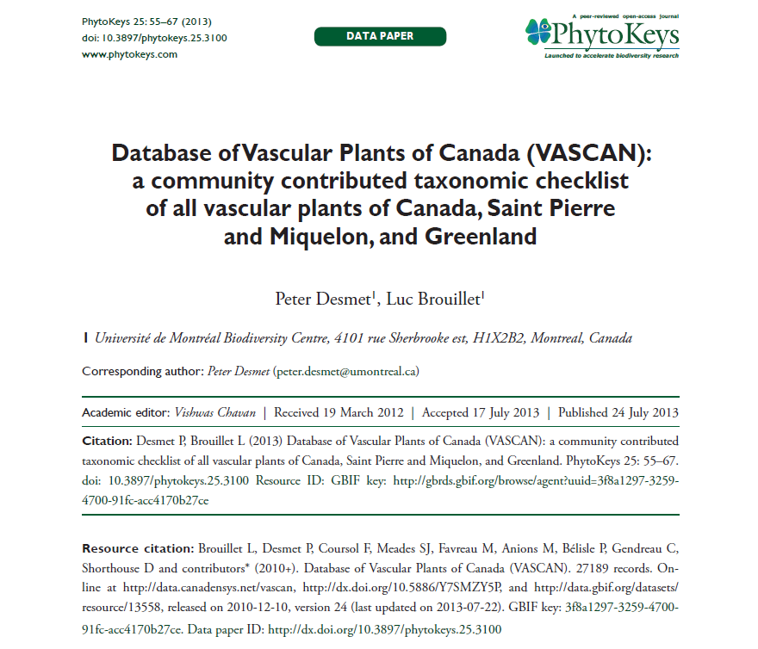

Slide 16
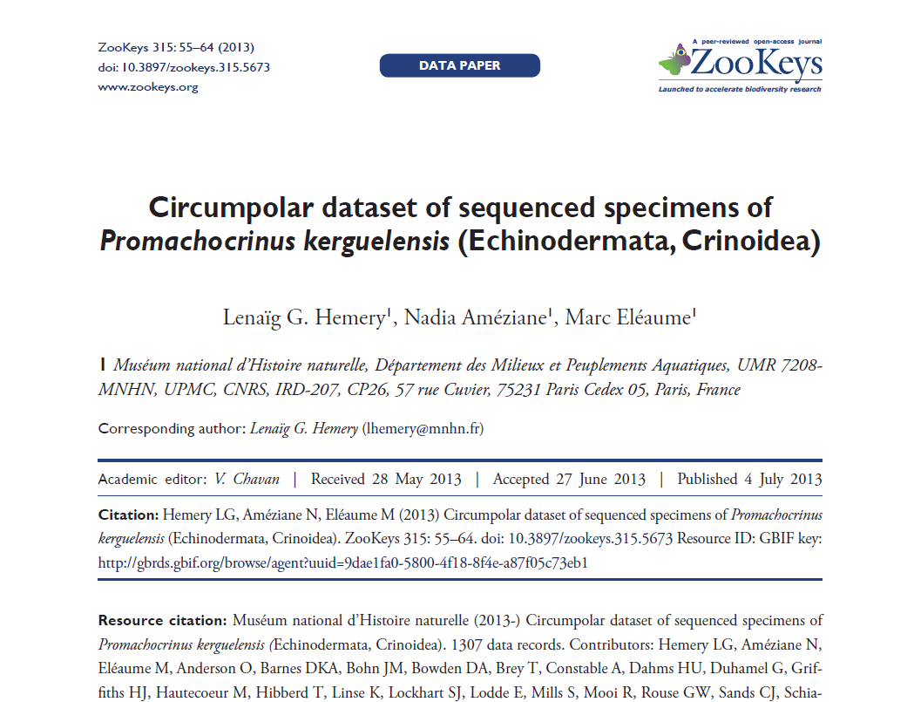

Slide 17
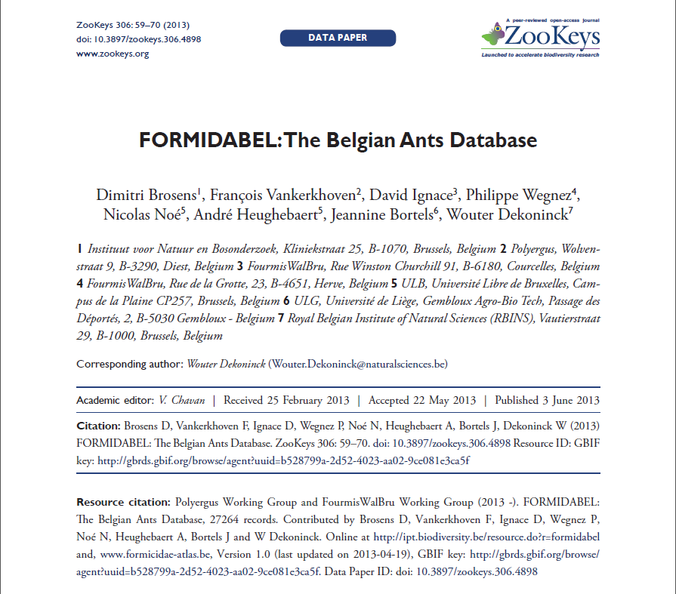

Slide 18
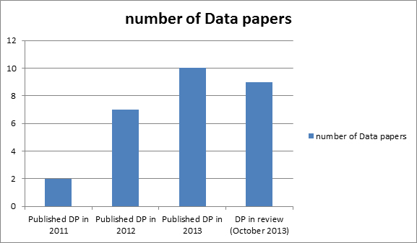
Growth

Slide 19
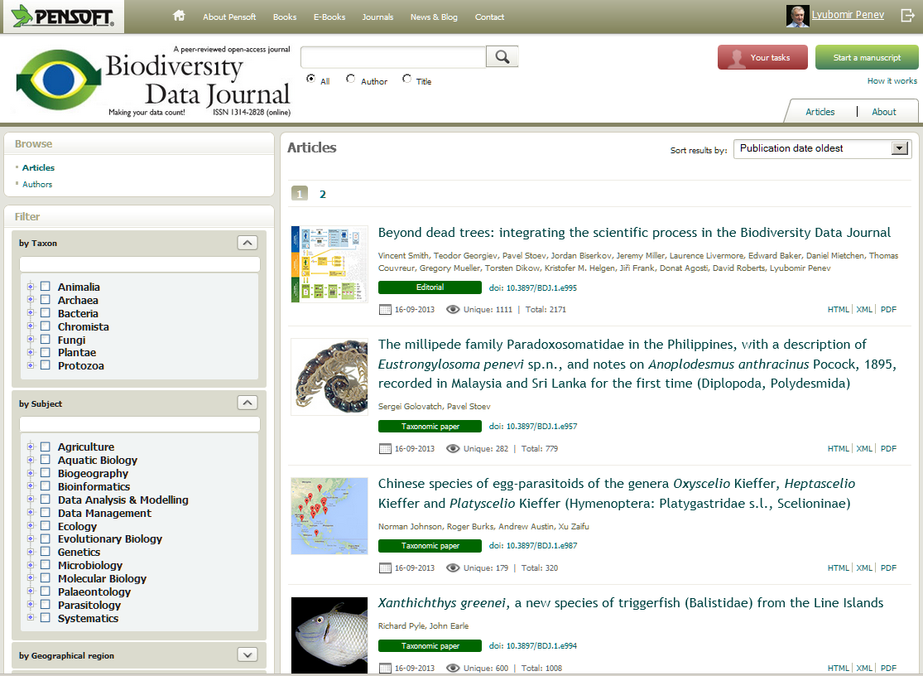
Next generation integrated text and data publishing

Slide 20
Harvesting data straight from article

Slide 21
Acknowledgements
ViBRANT
PLAZI

